Slide 1
DEVELOPMENT OF A SYSTEM FOR FAST VIDEO DECODING IN AV1 FORMAT
Faculty of social economic and computer science
Department of informational technology in business
Perm
2026
Project proposal
performed by Ilya Bersenyov, ISD-22-2
Supervisor: V. V. Lanin

Slide 2

Introduction
Faculty of social economic and computer science
Разработка сервиса для классификации степени артроза по рентген снимкам
Берсенёв И.И
TAPe indexer is something like a one-way video encoder
Cause: TAPe average time to index is about 24 times faster than to decode a video
Effect: a large bottleneck in TAPe’s current pipeline
Goal: close the gap

Slide 3
Relevance and hypothesis
Faculty of social economic and computer science
Разработка сервиса для классификации степени артроза по рентген снимкам
Берсенёв И.И
Object of study
libaom – the reference AV1 decoder
(spec v1.0.0 errata 1)
Subject of study
Decoding performance at 64 px output, single-threaded, no CUDA
Research aim is to design, implement and evaluate algorithmic optimisations for AV1 decoding at ultra-low output resolution in a single-threaded environment.
Hypothesis: Targeted algorithmic changes to the bottleneck stages of Libaom can reduce total system decoding time by 30–50 % while preserving acceptable video quality (PSNR ≥ 15 dB).

Slide 4
Research progress
Faculty of social economic and computer science
Разработка сервиса для классификации степени артроза по рентген снимкам
Берсенёв И.И
Functional and non-functional requirements
Analysis of the AV1 Decoding specification
Identification of bottlenecks in the standard
Identification of all the methods to speed up the code
Choosing the technology stack
Designing the naive realization and the optimized realization
Implementing the realizations
Testing the realizations

Slide 5
Theoretical background
Факультет социально-экономических и компьютерных наук
Разработка сервиса для классификации степени артроза по рентген снимкам
Берсенёв И.И
The most resource-intensive components according to Chen et al. (2018):
Interpolation
Deblocking filter
Constrained directional enhancement filter

Slide 6
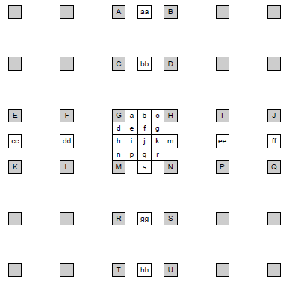
Interpolation
Факультет социально-экономических и компьютерных наук
Разработка сервиса для классификации степени артроза по рентген снимкам
Берсенёв И.И
Key point: it is very expensive.
8 coefficients 1d interpolation is the product of two vectors consisting of 8 numbers which is about 48 CPU cycles provided that multiplication takes 4 cycles and addition takes one cycle.

Slide 7
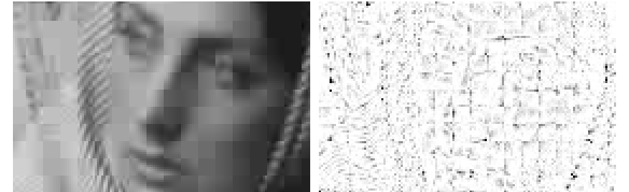
DF (Deblocking Filter)
Факультет социально-экономических и компьютерных наук
Разработка сервиса для классификации степени артроза по рентген снимкам
Берсенёв И.И
Key point: it is unnecessary in ultralow resolution.
DF is a method of reducing the blockiness of an image but is unnecessary in 64px resolution.

Slide 8
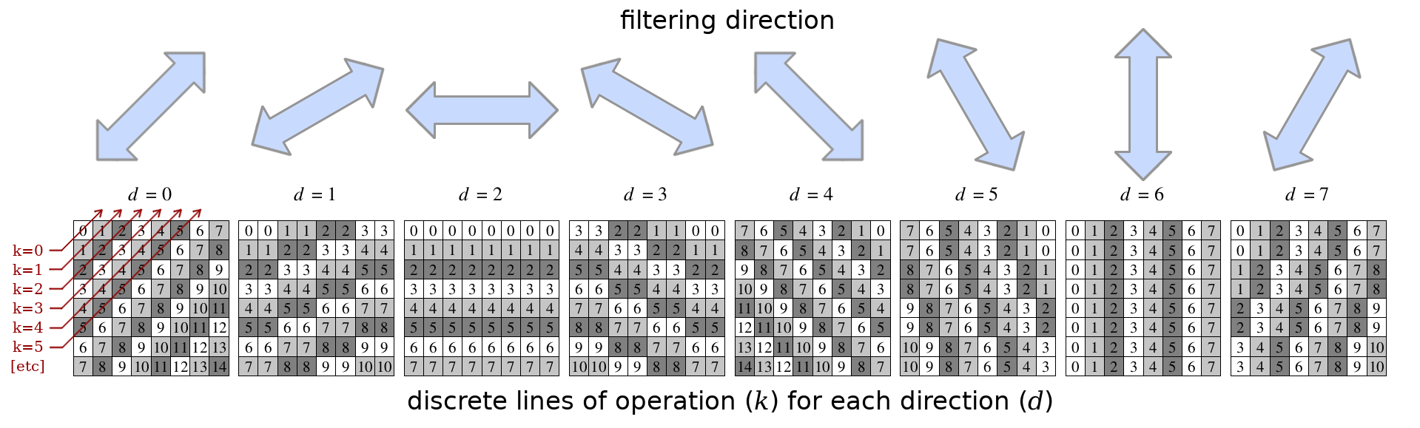
CDEF (Constrained Directional Enhancement Filter)
Факультет социально-экономических и компьютерных наук
Разработка сервиса для классификации степени артроза по рентген снимкам
Берсенёв И.И
Key point: it is too expensive operation.
CDEF is applied after the DF and is being used to make transitions between the canvas smoother.

Slide 9
Lookup tables
Факультет социально-экономических и компьютерных наук
Разработка сервиса для классификации степени артроза по рентген снимкам
Берсенёв И.И
Key point: it is faster than dynamic calculation but may lead to a lot of cache misses
Some values are “hard-coded” as arrays of values, where indexes are treated as function arguments.
Example:
double[] cos = {1.0,0.5,-0.4,-0.9,-0.7,0.2, …}; float x = cos[2];
Instead of
double x = cos(2)
However, as
Yi & Song (2008) state, excessive use may be harmful for the performance

Slide 10
Methodological base
Факультет социально-экономических и компьютерных наук
Разработка сервиса для классификации степени артроза по рентген снимкам
Берсенёв И.И
Replacing lookup tables with algebraic expressions (Yi & Song, 2008 — CAVLC for H.264): reduces memory footprint and eliminates cache misses on coefficient arrays.
Bitwise arithmetic optimization — "magic constant" division (Moroz & Samotyy, 2018): ≈30 % speedup on division-heavy interpolation paths.
Context-adaptive filter bypassing (Ren & Kehtarnavaz, 2007): skip costly post-processing steps when the target output is already ≤64 px.
Bentley optimisation rules + CPU-cache layout improvements: spatial locality in pixel buffers, prefetch-friendly access patterns.

Slide 11
Metrics used
Факультет социально-экономических и компьютерных наук
Разработка сервиса для классификации степени артроза по рентген снимкам
Берсенёв И.И
Total time from the upload to the end of the decoding process
Time to decode a video
A frame-by-frame metric estimated by the difference in brightness between each pixel of the original frame and the decoded one
Peak Signal-to-Noise Ratio (PSNR)
Stability and reproducibility of the obtained optimizations for Libaom, confirmed by at least five test runs with the same input data
Time to response in high load scenario
Compared to naive realization

Slide 12
Plan of the practice part
Факультет социально-экономических и компьютерных наук
Разработка сервиса для классификации степени артроза по рентген снимкам
Берсенёв И.И
Implementing the naïve realization
Implementing the optimized realization
Lookup table
Cache-optimized buffer pixel layout
Analytic substitution (interpolation coefficients)
Skip/simplify CDEF and DF at 64 or less px output
Evaluating the realizations

Slide 13
Expected results
Факультет социально-экономических и компьютерных наук
Разработка сервиса для классификации степени артроза по рентген снимкам
Берсенёв И.И
Total time to decode – 20-35% speed increasing
Time to decode – 30-50% speed increasing at minimum 5 runs
Confirmation of acceptable quality degradation
PSNR ≥ 15Db
Absence of critical artifacts affecting TAPe functionality

Slide 14
References
Факультет социально-экономических и компьютерных наук
Разработка сервиса для классификации степени артроза по рентген снимкам
Берсенёв И.И
Akyazi, P., & Ebrahimi, T. (2018). Comparison of Compression Efficiency between HEVC/H.265, VP9 and AV1 based on Subjective Quality Assessments. IEEE, 1–6. https://doi.org/10.1109/qomex.2018.8463294
Alliance for Open Media. (2021). AV1 bitstream & decoding process specification (Version 1.0.0-errata1). https://aomediacodec.github.io/av1-spec/av1-spec.pdf
Chen, Y., Murherjee, D., Han, J., Grange, A., Xu, Y., Liu, Z., Parker, S., Chen, C., Su, H., Joshi, U., Chiang, C., Wang, Y., Wilkins, P., Bankoski, J., Trudeau, L., Egge, N., Valin, J., Davies, T., Midtskogen, S., . . . De Rivaz, P. (2018). An Overview of Core Coding Tools in the AV1 Video Codec. IEEE, 41–45. https://doi.org/10.1109/pcs.2018.8456249
Guo, B., Han, Y., & Wen, J. (2018). Fast Block Structure Determination in Av1-Based Multiple Resolutions Video Encoding. IEEE, 1–6. https://doi.org/10.1109/icme.2018.8486492
ITU-T. (2021). Advanced video coding for generic audiovisual services (Recommendation ITU-T H.264). International Telecommunication Union. https://www.itu.int/rec/T-REC-H.264/en
Han, J., Li, B., Mukherjee, D., Chiang, C., Grange, A., Chen, C., Su, H., Parker, S., Deng, S., Joshi, U., Chen, Y., Wang, Y., Wilkins, P., Xu, Y., & Bankoski, J. (2021). A technical overview of AV1. Proceedings of the IEEE, 109(9), 1435–1462. https://doi.org/10.1109/jproc.2021.3058584
Moroz, L., & Samotyy, V. (2018). Efficient Floating-Point Division for Digital Signal Processing Application [Tips & Tricks]. IEEE Signal Processing Magazine, 36(1), 159–163. https://doi.org/10.1109/msp.2018.2875977
Ren, J., & Kehtarnavaz, N. (2007). Algorithmic Optimization for H.264 Deblocking Filter on Portable Devices. IEEE, 15, 1–6. https://doi.org/10.1109/isce.2007.4382168
Richardson, I. E. (2010). The H.264 Advanced Video Compression Standard. https://doi.org/10.1002/9780470989418
Yi, Y., & Song, B. C. (2008). High-Speed CAVLC encoder for 1080p 60-Hz H.264 CodeC. IEEE Signal Processing Letters, 15, 891–894. https://doi.org/10.1109/lsp.2008.2001982

Slide 15
Thank you for your attention
Факультет социально-экономических и компьютерных наук
Разработка сервиса для классификации степени артроза по рентген снимкам
Берсенёв И.И

Slide 16


